Slide 1

MACHINE LEARNING
S1-23_AIMLCZG565
WEBINAR-3
BITS Pilani
BITS Pilani
Pilani Campus
Pilani Campus
Mrs. Abinaya Marimuthu I

Slide 2


BITS Pilani
Pilani|Dubai|Goa|Hyderabad
Logistic Regression
2

Slide 3

Agenda
Introduction
Logistic Function
Types of Logistic Regression
How to evaluate the model
Demo

Slide 4
Introduction
Mainly used for binary classification which using sigmoid function.
Takes input as independent variables and produces a probability value 0 and 1.
Here we set a threshold value. If the input is greater than threshold (0.5) then it belongs to class 1 or class 0.
Output forms can be either yes or no, 0 or 1, True or False.

Slide 5
Introduction
Hours studying | Pass/Fail
1 | 0
1.5 | 0
2 | 0
3 | 1
3.25 | 0
4 | 1
5 | 1
6 | 1
Pass/Fail
Class 1
Class 0
Hours of Studying

Slide 6
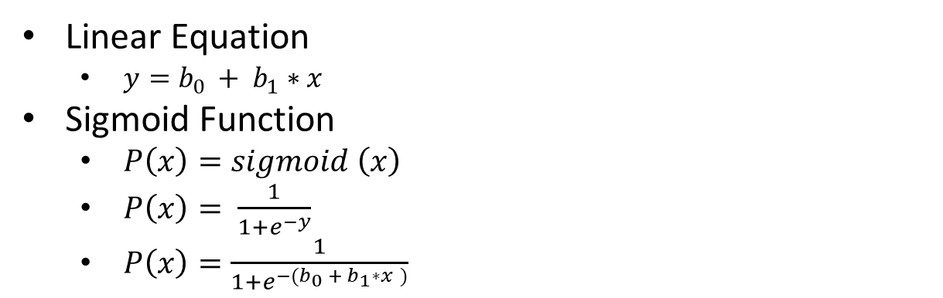
Logistic Function – Sigmoid Function
Linear Equation
$y=b_{0 }+ b_{1}∗x$
Sigmoid Function
$P\left(x\right)=sigmoid \left(x\right)$
$P\left(x\right)= \frac{1}{1+e^{−y}}$
$P\left(x\right)=\frac{1}{1+e^{−(b_{0 }+ b_{1}∗x )}}$

Slide 7
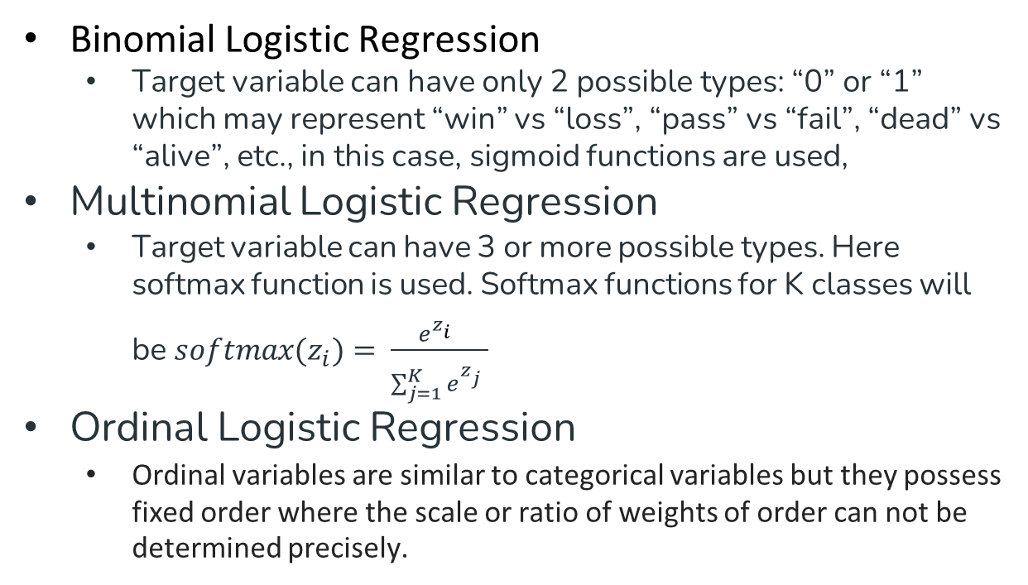
Types of Logistic Regression
Binomial Logistic Regression
Target variable can have only 2 possible types: “0” or “1” which may represent “win” vs “loss”, “pass” vs “fail”, “dead” vs “alive”, etc., in this case, sigmoid functions are used,
Multinomial Logistic Regression
Target variable can have 3 or more possible types. Here softmax function is used. Softmax functions for K classes will be $softmax(z_{i})= \frac{e^{z_{i}^{}}}{\sum_{j=1}^{K}{e^{z_{j}^{}}}}$
Ordinal Logistic Regression
Ordinal variables are similar to categorical variables but they possess fixed order where the scale or ratio of weights of order can not be determined precisely.

Slide 8
Case Study
Facebook Predict customer click
Running a targetted marketing ads on facebook. The company wants to anaylze customer behaviour by predicting which customer clicks on the advertisement
Inputs – Name, e-mail, Country, Time Spent on FB, Estimated Salary(Derived from other parameter).
Goals – Predict click on the ad.
1 : Customer click on ad
0 : Customer did not click on the ad

Slide 9
Evaluate the model
Accuracy: Accuracy provides the proportion of correctly classified instances.
Precision: Precision focuses on the accuracy of positive predictions.
Recall (Sensitivity or True Positive Rate): Recall measures the proportion of correctly predicted positive instances among all actual positive instances.
F1 Score: F1 score is the harmonic mean of precision and recall
Area Under the Receiver Operating Characteristic Curve (AUC-ROC): The ROC curve plots the true positive rate against the false positive rate at various thresholds. AUC-ROC measures the area under this curve, providing an aggregate measure of a model’s performance across different classification thresholds

Slide 10
Demo

